Slide 1
10 June 2020

Slide 2

APPLIED CRYPTOGRAPHY
Lecture 27

Slide 3
Prime Number, Primitive Root
Divisible by 1 and itself

Slide 4
Overview
To introduce prime numbers and their applications in cryptography.
Asymmetric-key cryptography uses primes extensively.
Finding an algorithm to correctly and efficiently test a very large integer and output a prime or a composite has always been a challenge in number theory, and consequently in cryptography.

Slide 5
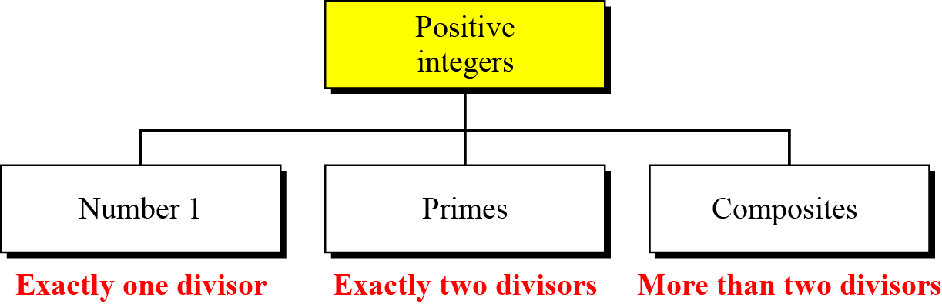
Topics discussed in this section
An integer p>1 that is divisible only by 1 and itself is called a prime number, otherwise it is called composite.
Example for prime numbers: 2,3,5,7

Slide 6
Relatively Prime
Two integers are relatively prime (or co-prime) if there is no integer greater than one that divides them both (that is, their greatest common divisor is one).
For example:
12 and 13 are relatively prime, but 12 and 14 are not.
10 June 2020

Slide 7

Checking for Primeness
Given a number n, how can we determine if n is a prime?
The answer is that, need to see if the number is divisible by all primes less than
This method is inefficient, but it is a good start.
10 June 2020

Slide 8
Examples
Is 97 a prime?
Is 131 a prime?
10 June 2020

Slide 9
Euler’s phi-function
Euler’s phi-function, f (n), which is sometimes called the Euler’s
totient function plays a very important role in cryptography.
8 July 2020

Slide 10
Continued..
We can combine the above four rules to find the value of f(n). For
example, if n can be factored as n = p₁^{e1} × p₂^{e2} × … × p_{k}^{ek}
then we combine the third and the fourth rule to find
The difficulty of finding f(n) depends on the difficulty of finding the factorization of n.
8 July 2020

Slide 11
Examples
What is the value of φ(13)?
What is the value of φ(10)?
10 June 2020

Slide 12
Examples
What is the value of f(240)?
Can we say that f(49) = f(7) × f(7) = 6 × 6 = 36?
10 June 2020

Slide 13
Examples
What is the prime number of elements Z₁₄*?
10 June 2020

Slide 14
Fermat’s Little Theorem
Two versions of the theorem.
1. If p is a prime and a is an integer such that p does not divide a,
then
2. If p is a prime and a is an integer, then
a^{p − 1} ≡ 1 mod p
a^{p} ≡ a mod p

Slide 15
Examples
Find the result of 6¹⁰ mod 11.
Find the result of 3¹² mod 11.

Slide 16
Multiplicative Inverses
a⁻¹ mod p = a ^{p − 2} mod p
The answers to multiplicative inverses modulo a prime can be found without using the extended Euclidean algorithm:

Slide 17
Euler’s Theorem
First Version
Second Version
The second version of Euler’s theorem is used in the RSA
cryptosystem.
a^{φ(n)} ≡ 1 (mod n)
a ^{k × φ(n) + 1} ≡ a (mod n)
10 June 2020

Slide 18
Examples
Find the result of 6²⁴ mod 35.
Find the result of 20⁶² mod 77.
10 June 2020

Slide 19
Multiplicative Inverses
Euler’s theorem can be used to find multiplicative inverses modulo
a composite.
a⁻¹ mod n = a^{φ(n)−1} mod n
10 June 2020

Slide 20
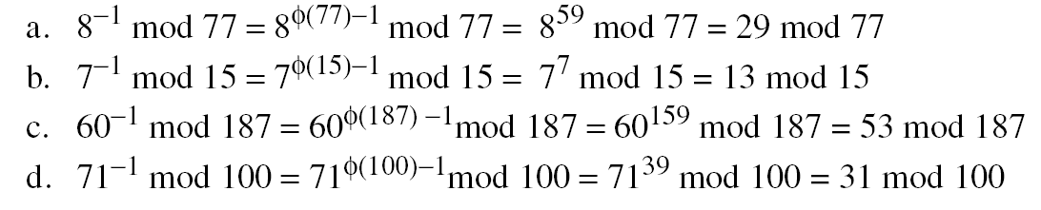
Examples
The answers to multiplicative inverses modulo a composite can be
found without using the extended Euclidean algorithm if we know
the factorization of the composite:

Slide 21
Generating Primes
A number in the form Mp=2^p -1 is called a Mersenne number
and may or may not be a prime.

Slide 22
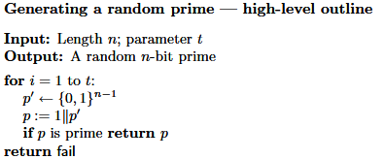
Generating Random Primes
10 June 2020

Slide 23
Deterministic Algorithms
The bit-operation complexity of the divisibility test is exponential.

Slide 24
Euclidean Algorithm
Let a, b be positive integers. Then there exist integers X, Y such that Xa + Yb = gcd(a, b).
Furthermore, gcd(a, b) is the smallest positive integer that can be expressed in this way.
10 June 2020

Slide 25
Example
Let a=210 and b=45.
Divide 210 by 45, and get the result 4 with remainder 30,
so 210=4·45+30.
Divide 45 by 30, and get the result 1 with remainder 15,
so 45=1·30+15.
Divide 30 by 15, and get the result 2 with remainder 0,
so 30=2·15+0.
The greatest common divisor of 210 and 45 is 15.
10 June 2020

Slide 26
Primitive Root
Primitive root of a prime number n is an integer r between [1,n-1] such that the values of r^x(mod n) where x is in range[0,n-2] are different.
Table 9.5 shows the result of a^{i} ≡ x (mod 7) for the group
G = <Z₇∗, ×>. In this group, φ(7) = 6

Slide 27
Thank You!
Next Class
Mandatory reading for the next class
https://www.math.upenn.edu/~mlazar/math170/notes06.pdf
10 June 2020

Slide 28


Vineetha B
Computer Science and Engineering
PES University, Bengaluru
10 June 2020

